Slide 1
Software Market Research:
Team Pinpoint Andy Hoang, Citlally Vasquez, Darrel Dennis, Max Ju, Troy Waters, Wai Soltow

Slide 2

Recap
Local focused social media program - Users may post freely with visibility tied to proximity
Localized content – strengthen community by focusing on local events and discussion
Proximity prioritization – users see posts made near to them

Slide 3

Significance of this market research
Over-Reliance on Word of Mouth
Small group communities are fragmented
Lack of Intuitive Tools for Event Discovery
Concerns Over Event Legitimacy
Concerns Over Content Moderation

Slide 4
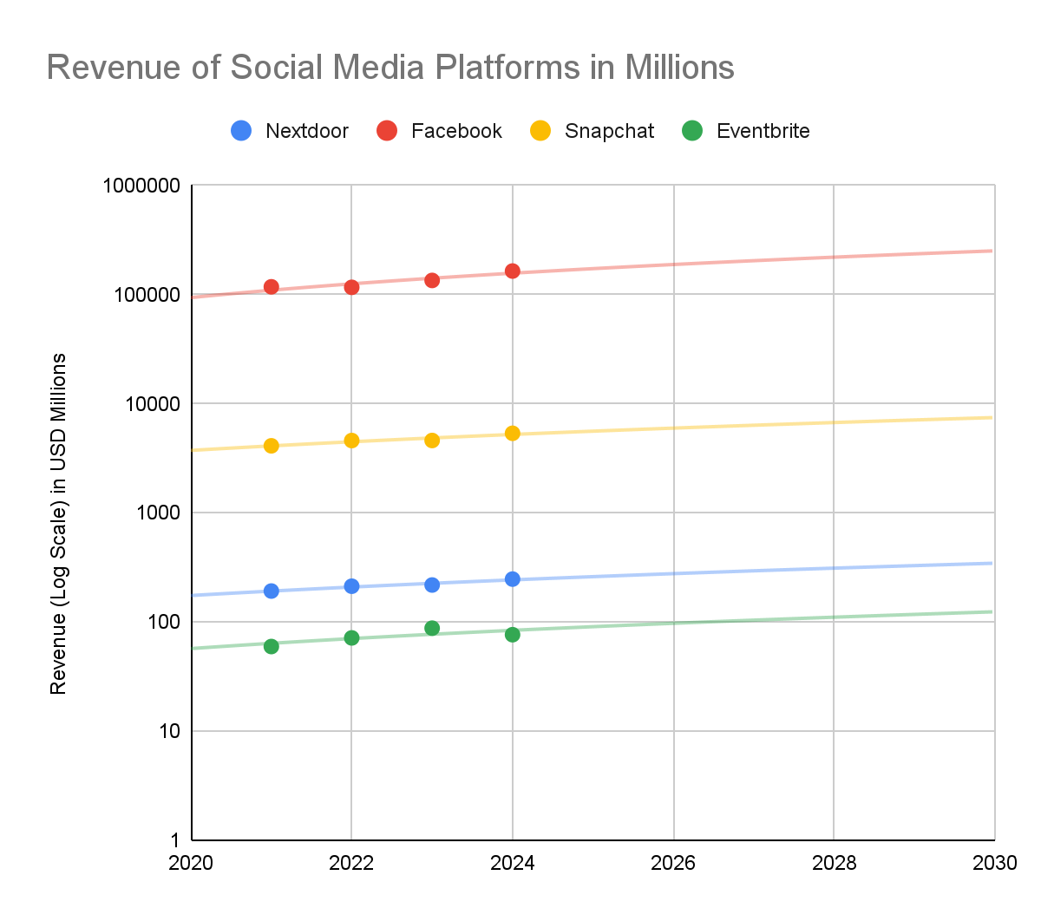
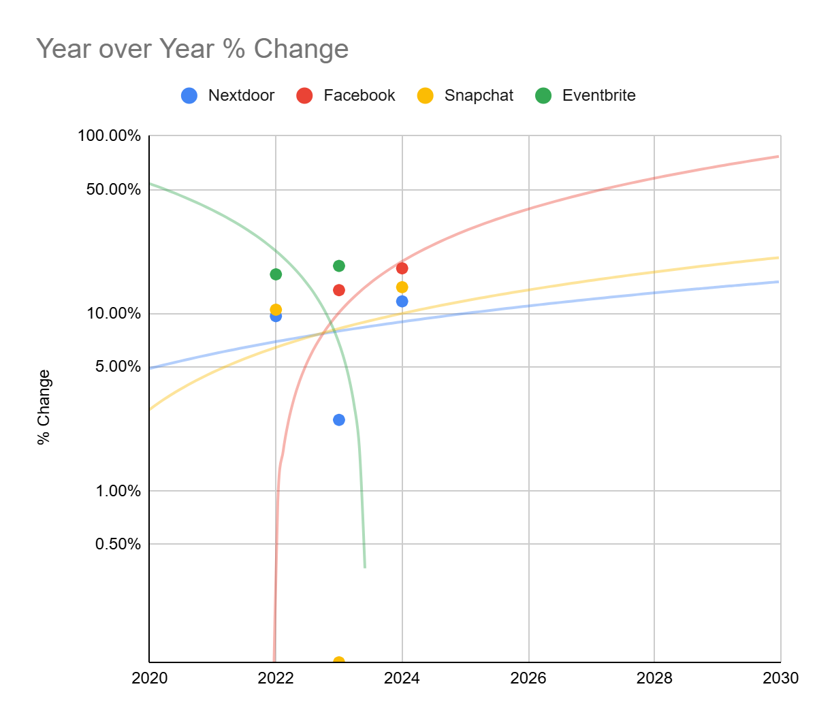
Market Size and Growth Trend
Notes:
Revenue of various social media platforms shown in a logarithmic scale with best fit. Linear change in a log graph indicates exponential growth in the original data. Nextdoor, Facebook, Snapchat: Concave down increasing best fit. Rate of growth (dy/dt) is decreasing, indicating they are reaching market saturation. Eventbrite: Concave down and decreasing best fit line. This indicates that revenues are decreasing at an increasing rate over time.

Slide 5
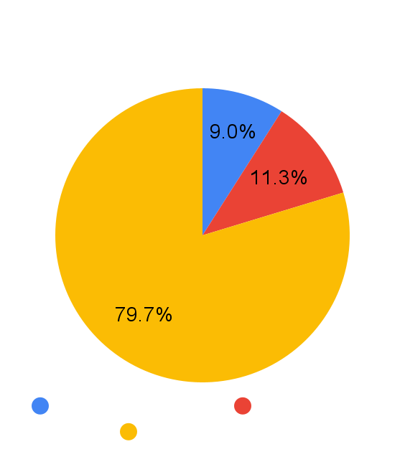
Major Players and Market Share:
General Observations
Market for local communications apps difficult to determine due to lack of specific data
Combined market capitalization of the 3 largest local communications apps (Nextdoor, Citizen, and Meetup) is around $310 million
Nextdoor notably had a 13% revenue increase from the previous year
Total value of entire global and local social networking, instant messaging, and mobile messaging valued at billions in total
No signs of slowing down in the future

Slide 6
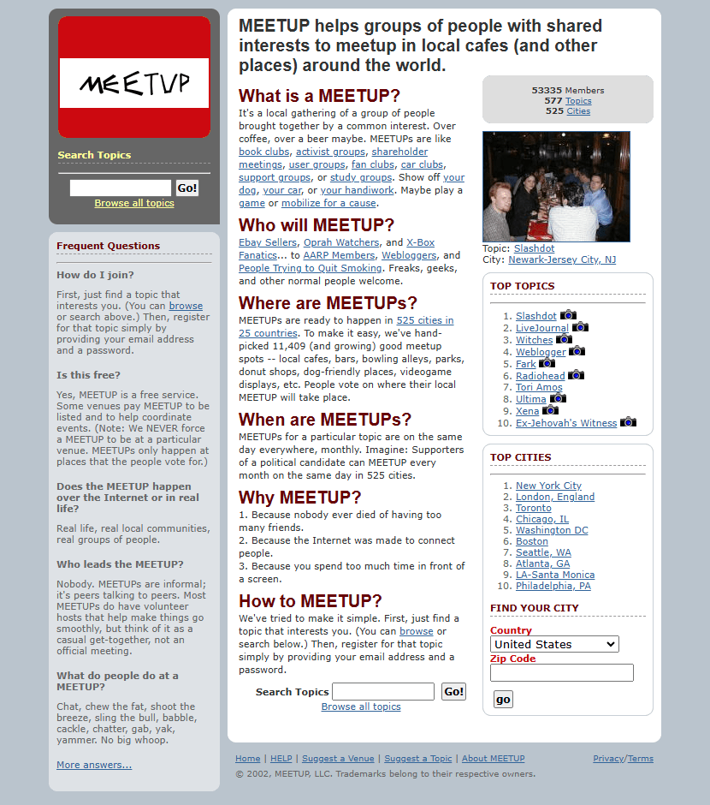
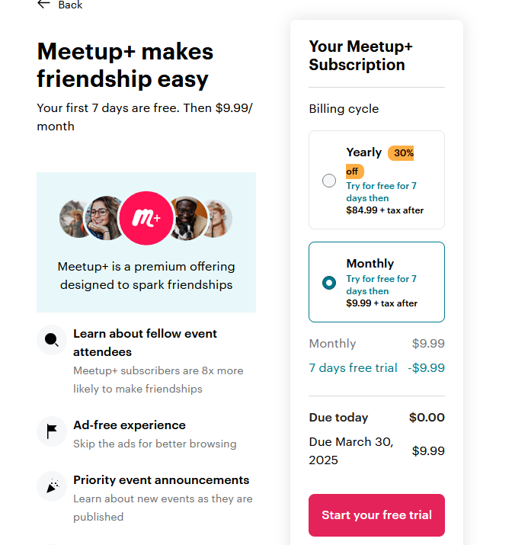
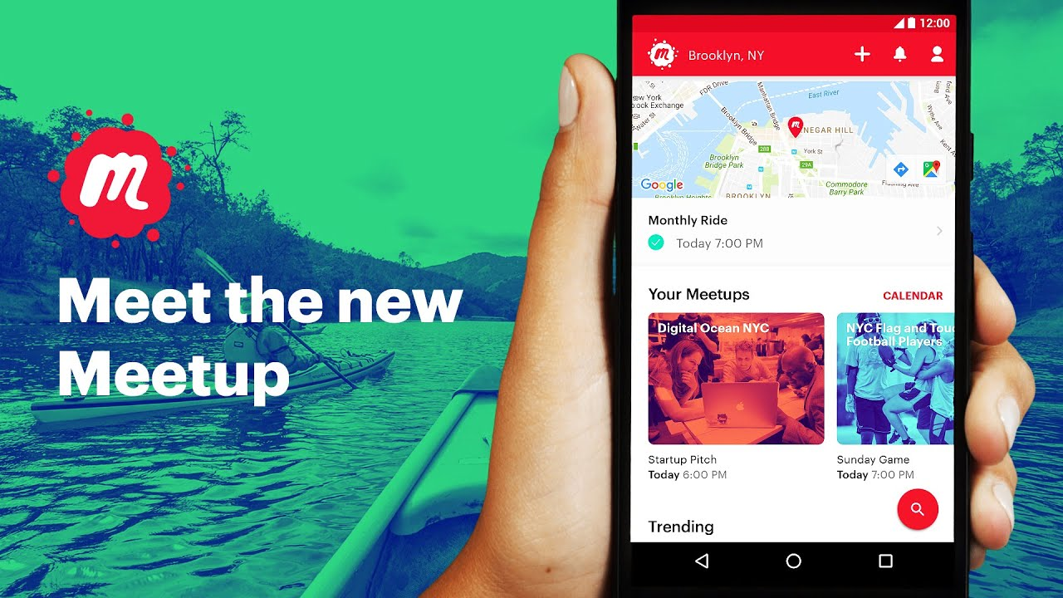
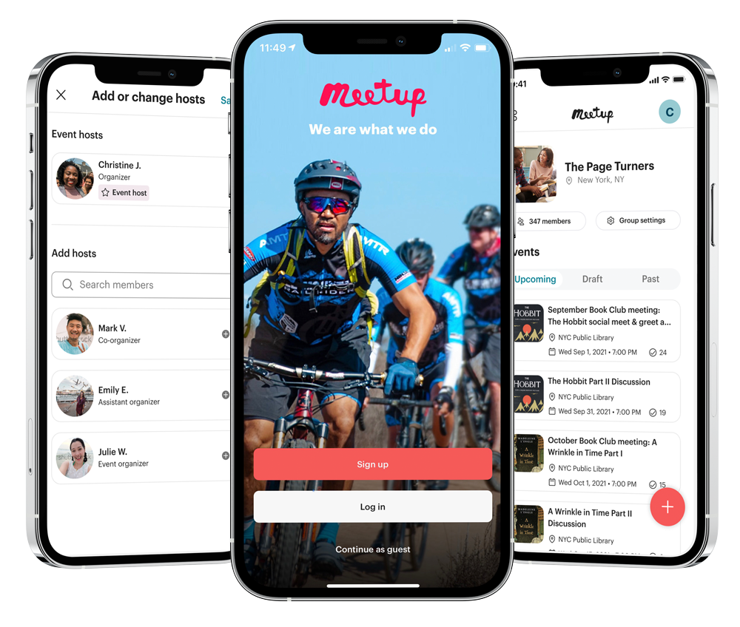


Meetup in 2002! vs 2025…
Troy Waters

Slide 7
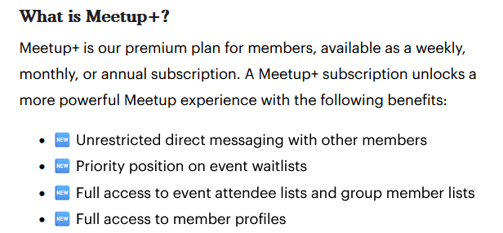
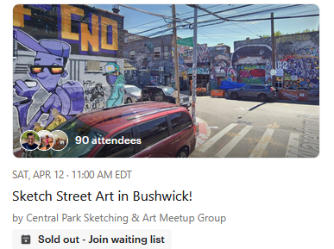
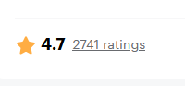

“Only insiders get inside”
Troy Waters
->Want to attend? Join the group. Pay.
->Where? Join the group. Pay. ->Who is the host? PAY.
Reviews (or Rants?): "The app requires full access to the calendar with no option to allow only limited permissions. Completely unacceptable from a privacy standpoint." … "A lot of bugs, horrible interface, and little attention to actual UX. It’s like the devs have never used their own product."
<-Group Reviews are NOT public, isn’t that suspicious?!

Slide 8
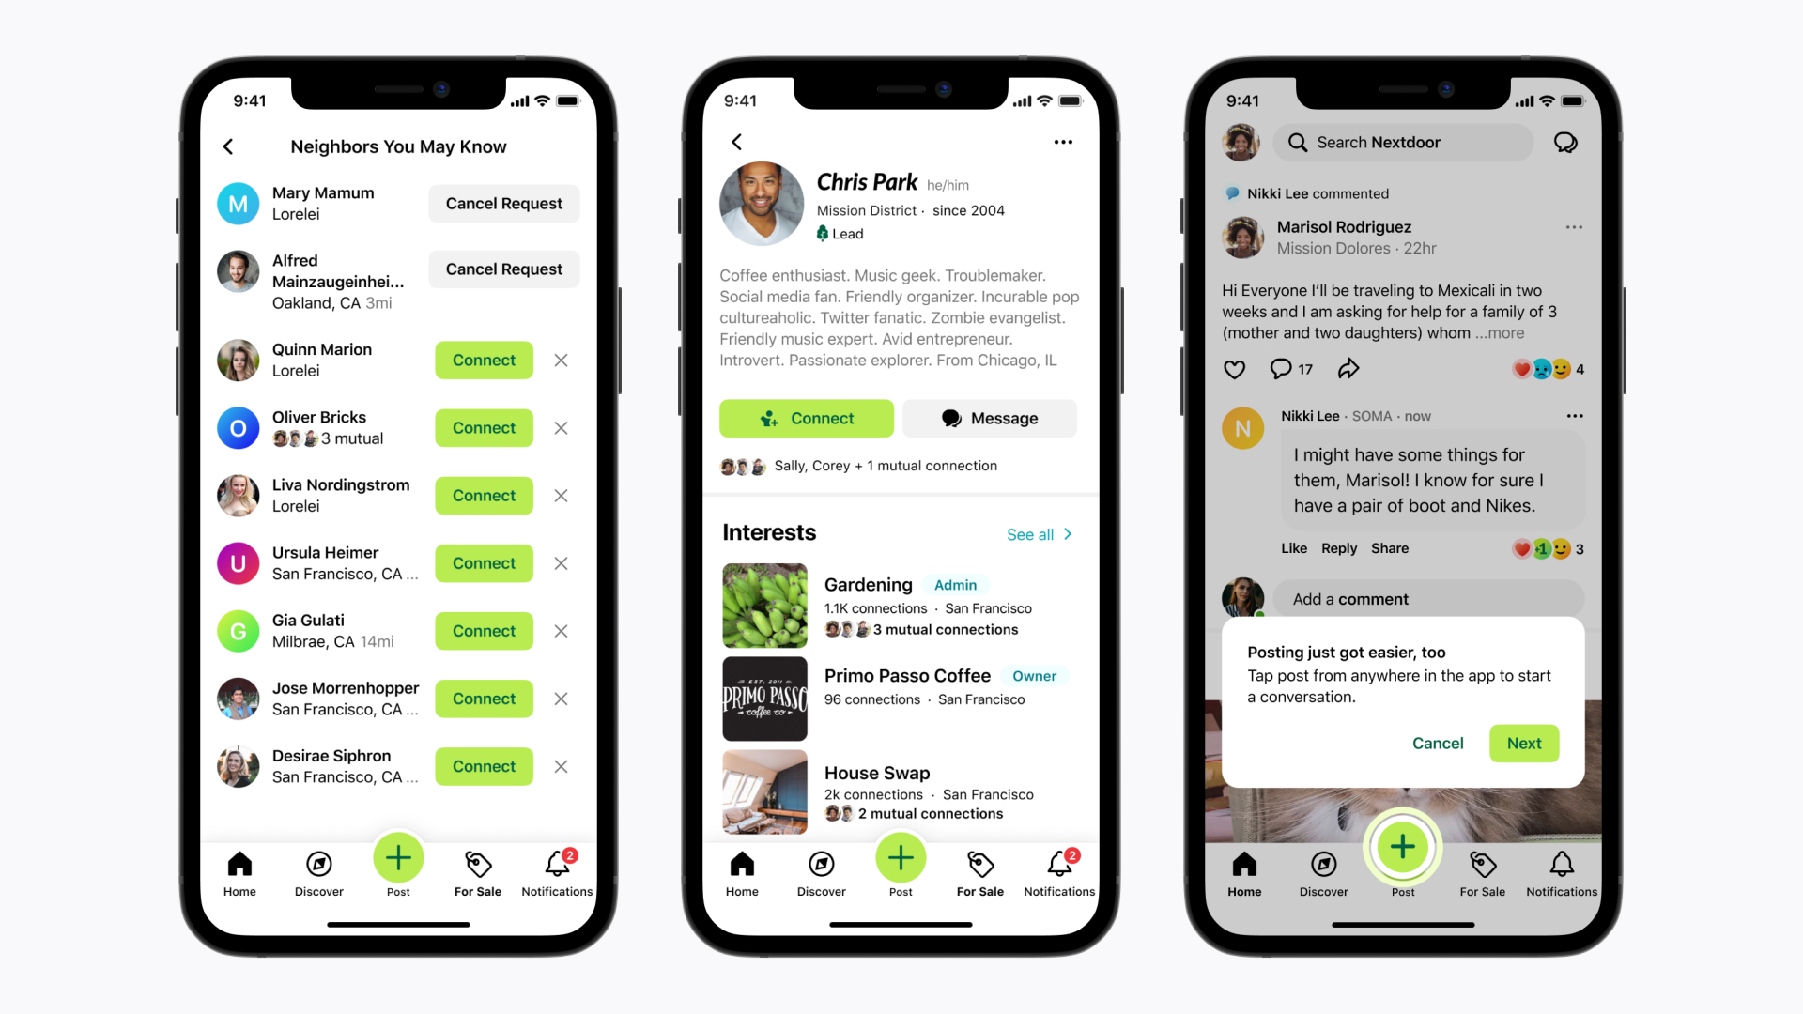

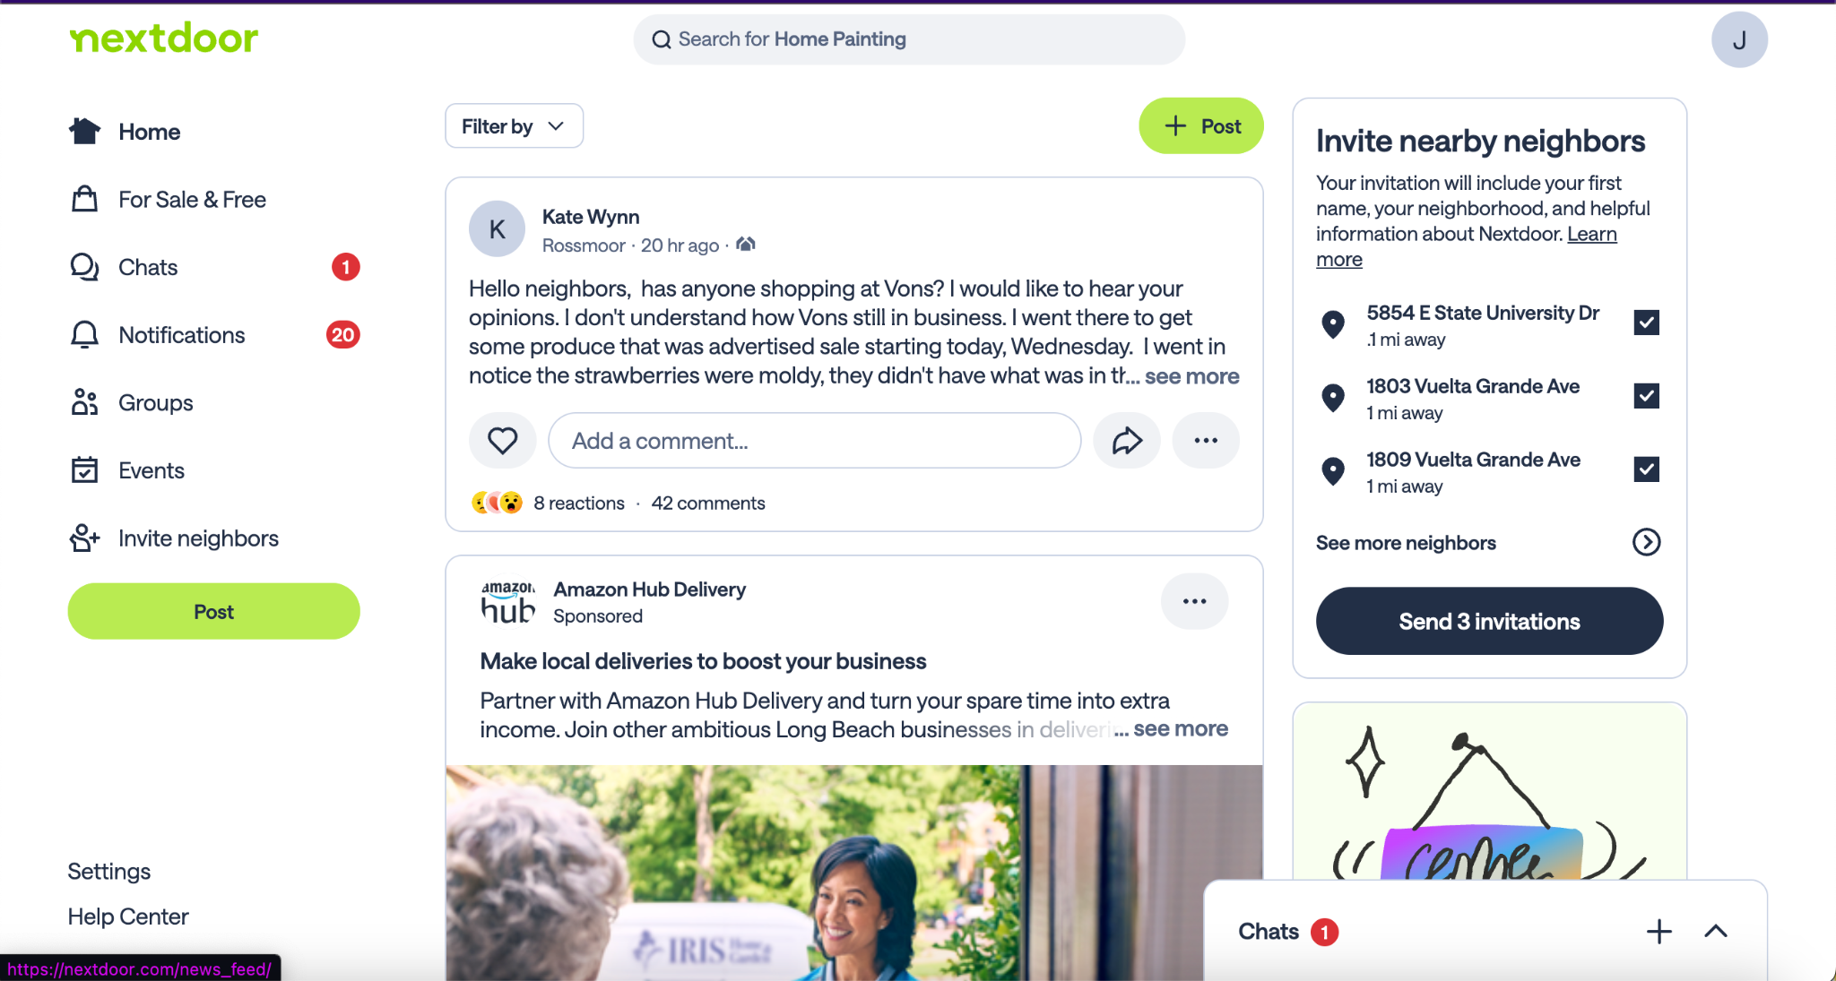
Competitor:Nextdoor
Created in 2011

Slide 9
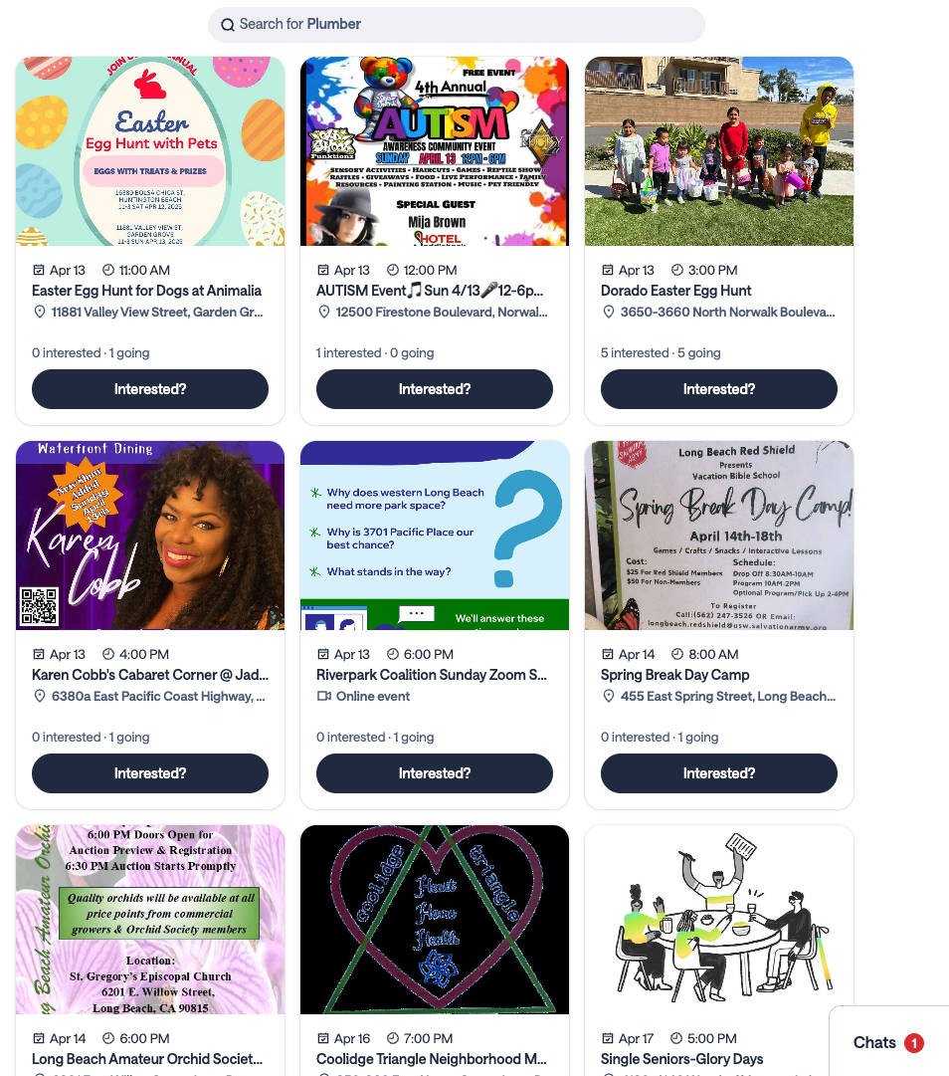
Nextdoor:Features
Public and Private group chats
Locals can:
Ask questions/Share updates
Buy or Sell items
General community interaction
“Events” Feature
Locals are able to create events and advertise them
Local businesses advertise their events
Majority of general reviews (55.19%) were under 2 stars
Fun YET it feels like a marketplace rather than a community

Slide 10
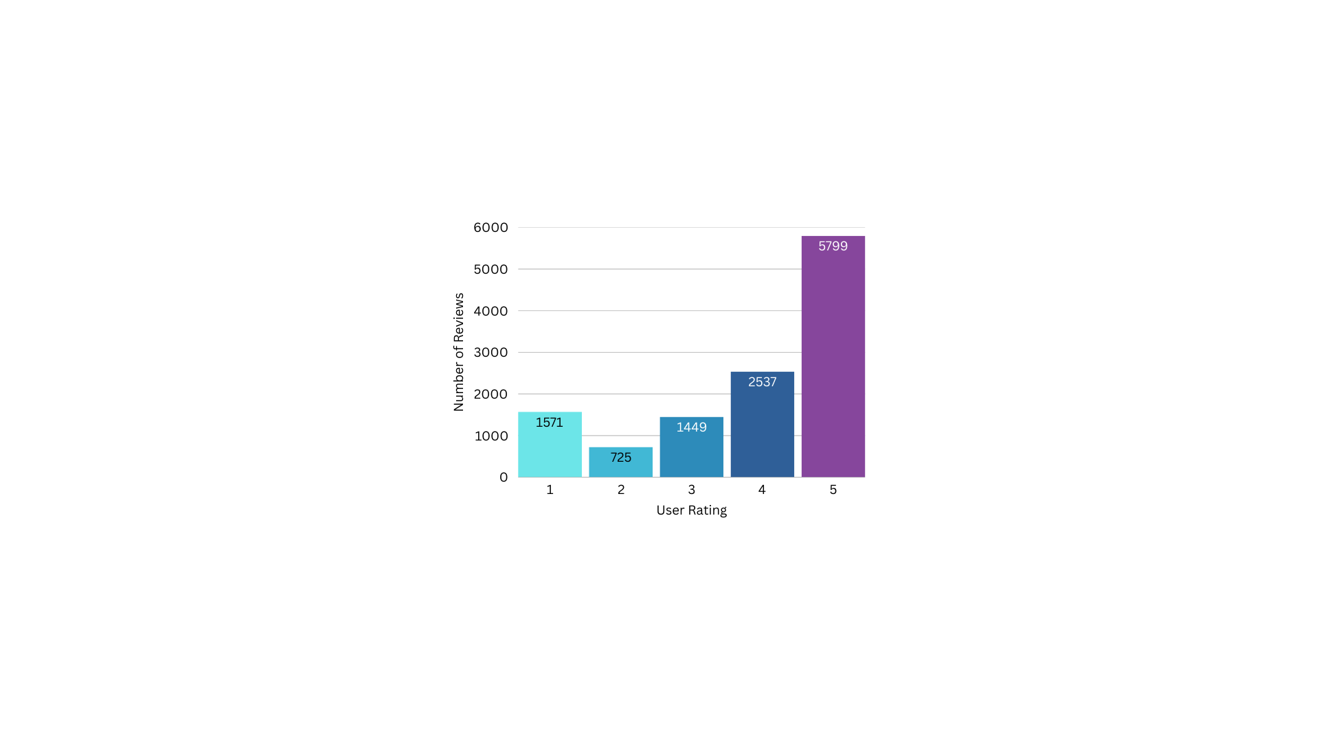
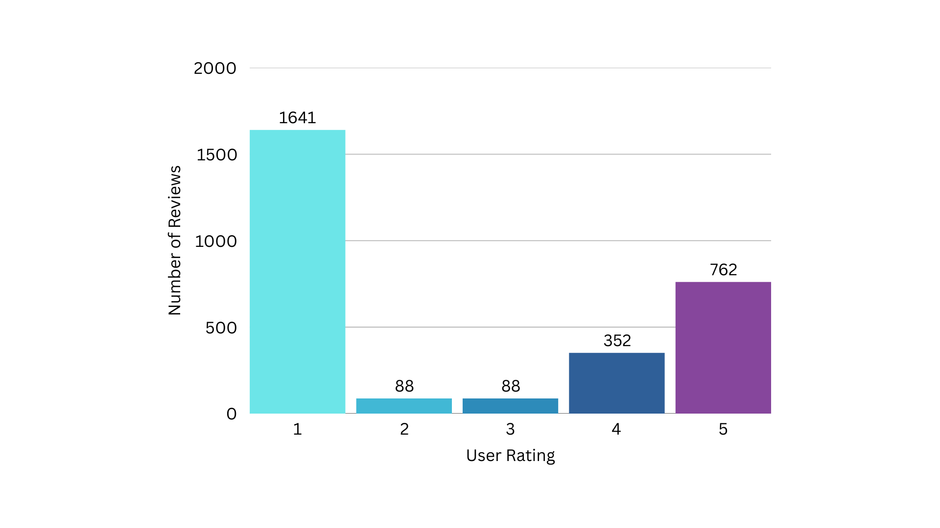
User Reviews/Ratings
User Ratings from last 5 years, United Kingdom
User Ratings from last 5 years,
United States
Overall Rating: 2.7
Overall Rating: 1.2

Slide 11
SWOT Analysis
STRENGTHS | WEAKNESSES
- Map Visualization - Localized Focus - Building community | - Getting users to switch to us - Limited reach - Moderation challenges
OPPORTUNITIES | THREATS
- Local business connections - Event promotion - In-App shop feature | - Competitors - Privacy concerns - Safety concerns

Slide 12
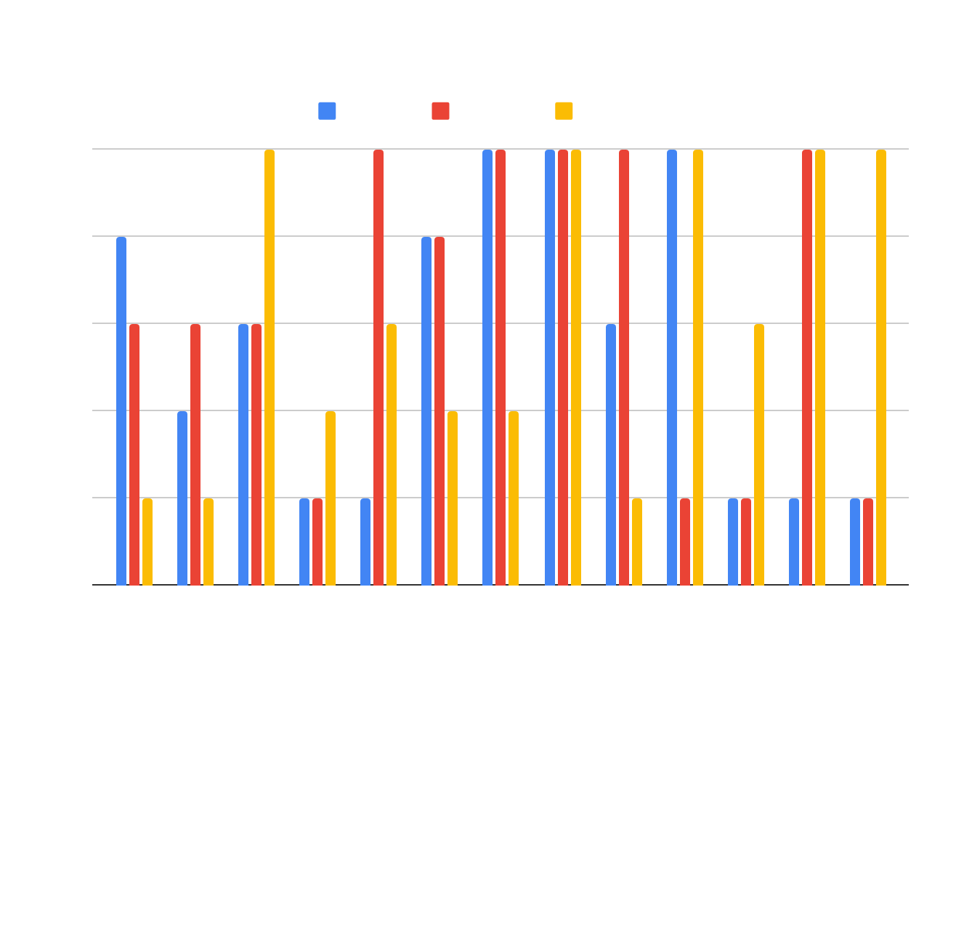
Gap Analysis
No service takes strong advantage of phone’s geolocation features, lacking in proximity based interactions
A lack of real time features
Posted content is tied to traditional text based feeds and not exploring map based feeds in depth
Services limit content visibility due to paywalls, group requirements, or focusing on a fixed location

Slide 13
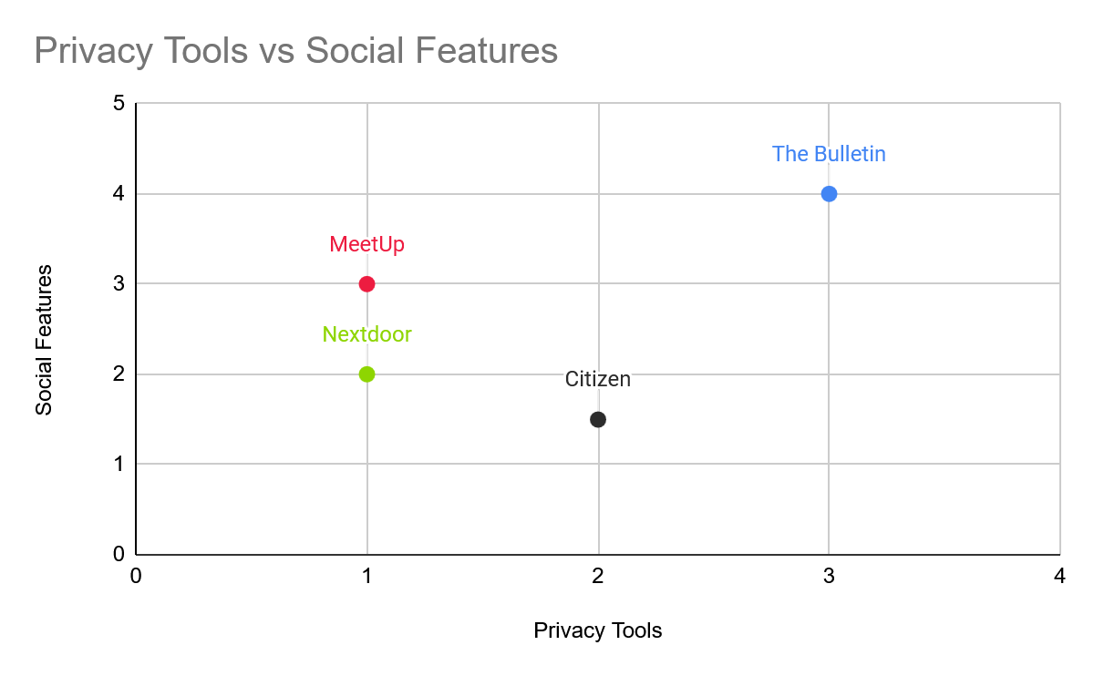
Differentiation
What makes us different?
less focus on engagement optimized algorithms
Visual map
Enhanced social features
Real-time local chat
Greater focus on security features

Slide 14


Potential challenges and strategies to address
What problems we may face:
Privacy & Security
Monetization
We could:
Implement end-to-end encryption
Have user-controlled data privacy
Tools for user anonymity
Create premium features that enhance experience

Slide 15
Summarization
To interact with the growing local communication market, we must:
Encourage fluid, current interactions with nearby users
Realtime public local chat, Public event pins that expire, Content have limited range for interaction/visibility
Change primary content delivery method to help users obtain a greater sense of proximity
Visual map with pins for posts and events
Expand reach beyond groups and neighborhoods
Allow use wherever and whenever via geolocation, Pins that everyone nearby can see
Explore funding opportunities without limiting audience
User customization, Strategic partnerships, Ads
Prioritize user privacy and security and offer features to inform users honestly
Location approximation, Data anonymization, End-to-end encryption, User controlled data collection, Event interest tracking, Never sharing a user’s current location
Notes:
Current platform limitations:
Focus on pre-existing groups
(Meetup, Facebook)
Limited interaction reach
(Ring, Nextdoor)
Linear text-based feeds
Our Solutions
Encourage fluid, current interactions
Realtime public local chat
Public event pins
Expanded reach using geolocation
Allow use wherever and whenever
Dynamic map based feeds
Visual map w/ pins
Sustainability & User Trust
Explore funding opportunities
User customization
Strategic partnerships
Ads
Prioritize user privacy and security
Location approximation
Data anonymization
End-to-end encryption
Offer features to inform users honestly
User controlled data collection
event interest tracking

Slide 16

Implications
Have to address what the people want: local integration, user privacy, and community
The most important finding is gaining user trust by not violating privacy, since this is a common trend between all local communications apps
Incorporate local integration, which will lead to the community aspect too
Can not find long term success without these being done

Slide 17
Gap Analysis
Feature / Experience | Meetup | Nextdoor | Gap/Opportunity
Account Access | Paywall at entry | Free, but asks for address | Account access not tied to a paywall or a fixed location
Event Discovery | Limited by groups | Limited to neighborhood | Event visibility that expands beyond group or neighborhoods
Content Outreach | Shrunken community due to paywall, poor app maintenance | Limited to neighborhood | Visibility that is local, but is applicable to any location
Navigation | Linear feed, text-based | Linear feed, text-based | Map-based browsing

Slide 18
Old Summarization
Current platform limitations:
Our Solutions
Sustainability & User Trust
Focus on pre-existing groups
(Meetup, Facebook)
Limited interaction reach
(Ring, Nextdoor)
Linear text-based feeds
Encourage fluid, current interactions
Realtime public local chat
Public event pins
Expanded reach using geolocation
Allow use wherever and whenever
Dynamic map based feeds
Visual map w/ pins
Explore funding opportunities
User customization
Strategic partnerships
Ads
Prioritize user privacy and security
Location approximation
Data anonymization
End-to-end encryption
Offer features to inform users honestly
User controlled data collection
event interest tracking
Notes:
Current platform limitations:
Focus on pre-existing groups
(Meetup, Facebook)
Limited interaction reach
(Ring, Nextdoor)
Linear text-based feeds
Our Solutions
Encourage fluid, current interactions
Realtime public local chat
Public event pins
Expanded reach using geolocation
Allow use wherever and whenever
Dynamic map based feeds
Visual map w/ pins
Sustainability & User Trust
Explore funding opportunities
User customization
Strategic partnerships
Ads
Prioritize user privacy and security
Location approximation
Data anonymization
End-to-end encryption
Offer features to inform users honestly
User controlled data collection
event interest tracking

Slide 19
Competitor features
Application Features | Meetup | Nextdoor | Citizen | Eventbrite | Snapchat
Location-Based Events | ✅ | ❓ | ❓ | ✅ | ❓
User Events | ✅ | ✅ | ⛔ | ✅ | ✅
Visual Map Feature | ⛔ | ❓ | ✅ | ✅ | ✅
Anonymous Options | ⛔ | ⛔ | ❓ | ⛔ | ❓
Local Chat | ✅ | ⛔ | ⛔ | ⛔ | ⛔
Image Sharing | ✅ | ✅ | ✅ | ⛔ | ✅
Mobile Application | ✅ | ✅ | ✅ | ✅ | ✅
Verification | ✅ | ✅ | ✅ | ✅ | ✅
Self-Destruct Messages | ⛔ | ⛔ | ✅ | ❓ | ✅

Slide 20
Detailed user reviews: Meetup
Majority (66%) were 4 stars and above. These users appreciated community engagement and saw improvements in API features
The negative reviews (3 stars and below) noted that the app had:
Glitches
Log-in issues
Difficulty navigating the interface
Privacy Concerns
“I recently signed up for a one-week trial period, however, to my surprise, on the third day of the trial, I discovered that Meetup had charged me an unauthorized amount of $500! I am now faced with the frustrating task of pursuing a refund from their customer support team. I hope that Meetup will address this issue promptly and efficiently, as this experience has left me disappointed in their service.”
- Meetup User

Slide 21
Detailed user reviews: Nextdoor
Majority (55.19%) were 2 stars and lower. These users noted:
Certain pages were useless
Privacy concerns over excessive data collection
Lack of moderation
Difficult to erase your data
The positive reviews (3 stars and above) liked the easy setup process and interface
“Don't sign up!!! The emails you get are absolutely and utterly ridiculous and they make it impossible to unsubscribe. I'm talking several times a day, every day, AFTER I tried to unsubscribe from the hundreds of categories of ‘notifications’”
Nextdoor User

